Slide 1
“Never let a pandemic go to waste: How the World Bank’s Covid-19 response is prioritising the private sector”
“Crash Course on debt crisis in the global south, and radical solutions”
María José Romero, Eurodad
15 December, 2020

Slide 2
Outline
The WBG’s ‘Maximising for Finance for Development’ (MFD) approach
WBG’s response to the pandemic – key features
  Public vs private arms of the WBG
  Who benefits from IFC’s Fast Track Covid-19 Facility support?
  Transparency, accountability and participation
  Structural reforms persist
  WBG’s approach to ‘building back better’
Conclusions and policy recommendations
References

Slide 3
WBG’s Maximising Finance for Development (MFD) (I)
The MFD approach builds on previous WBG’s strategies and is part of a broader agenda and trend which attempts to elevate the private sector at the heart of the development, including public service provision (health, education, etc….)
The broader agenda reveals a series of systematic positionings:
  unwillingness of donor community to scale up intl. public finance,
  inability to agree on a multilateral resolution to unsustainable sovereign debts,
  lack of resolve to create a global body to deal with mass tax avoidance and evasion,
  failure to deal with growing criticisms and negative evidence, and
  reflects a fundamental underlying prejudice against the public sector, which has been fuelled by austerity policies that have undermined its ability to deliver.

Slide 4
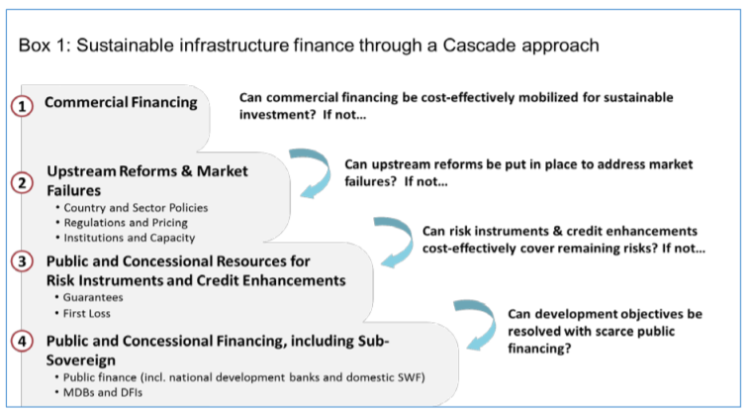
WBG’s MFD (II)
Source: Development Committee (2017), ‘Forward look – A vision for the World Bank Group in 2013, progress and challenges’

Slide 5
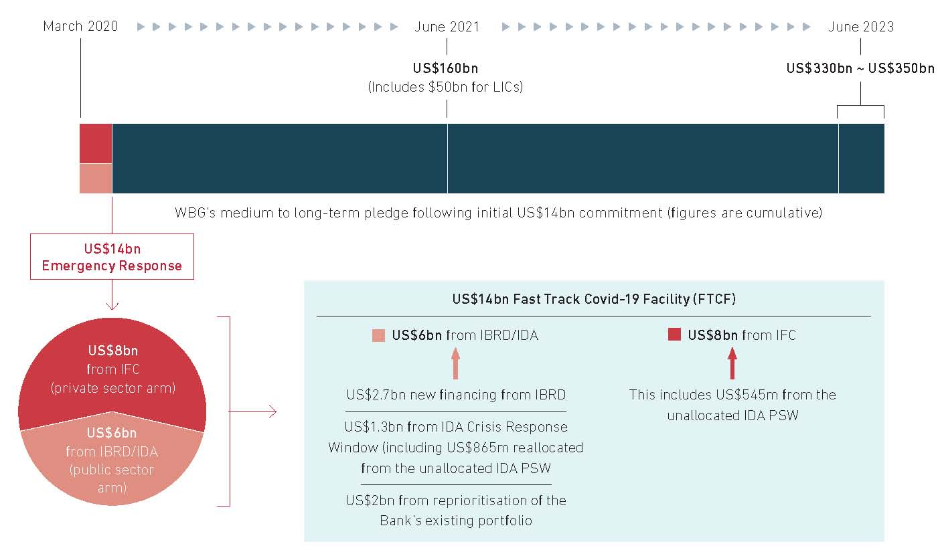
WBG’s response to the pandemic

Slide 6
WBG’s response to the Pandemic – Key features
Private clients over the Public Sector: Allocation across the public and private arms of the WBG
Almost 60% of emergency Covid-19 resources were allocated to the IFC. This does not respond to multiple calls across the policy spectrum for stronger public systems. The IFC has expanded its upstream work (i.e. enabling the ‘business environment’) and accelerated the disbursement of blended finance.

Slide 7
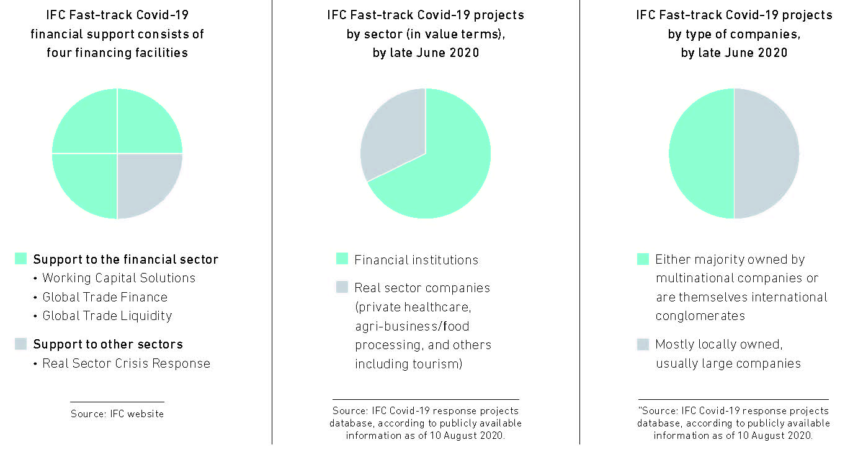
WBG’s response to the Pandemic – Key features
Who benefits from IFC projects
Financial Sector Financial Institutions Multinationals

Slide 8
WBG’s response to the Pandemic – Key features
Lack of transparency, accountability & local participation
IFC’s focus on financial institutions has fallen short with regard to transparency and accountability. On the WB’s side there has been very limited to no stakeholder engagement as projects are rolled out, which comes in addition to the shrinking space for CSOs to actively participate and increased reprisals against human rights activists by national governments.

Slide 9
WBG’s response to the Pandemic – Key features
Structural reforms to promote market creation persist
The WB remains set on structural reforms in support of liberalisation, deregulation and a reduced role of the state (e.g. Ethiopia, Kenya, Indonesia, Ecuador, etc.). Previously, these policies (= structural adjustment) resulted in adverse developmental and health outcomes, and negative impacts on gender equality.

Slide 10
WBG’s response to the Pandemic – Key features
WBG’s “Building Back Better” and the centrality of the private sector
The WBG is set to accelerate and scale-up WBG’s support for private sector solutions (incl. advisory services, policy guidelines and finance for PPP-related projects). The MFD approach successfully embeds the private sector across core public service provisioning.
  @Stephanie von Friedeburg" (interim IFC CEO, 13/10/2020) “Our cascade approach is more relevant now than ever. We need to leave the fiscal space for the poor and vulnerable. The IFC teams are engaged and involved with Bank colleagues to help private sector back on its feet.”
This is despite evidence regarding the multiple risks and implications of PPPs, including their high cost, fiscal risks, questionable effectiveness, and equity implications.

Slide 11
Conclusion and policy recommendations (I)
Main message: despite the rapid response, the WBG risks deepening previous problematic trends in development finance and public systems. The crisis is being used to further advance an agenda that risks creating debt vulnerabilities and undermining access to universal and high quality public services.
Short term policy recommendations (I):
Restore the balance between the public and private sector in its Covid-19 response, including in its modalities and instruments.
Both in its emergency response and with regard to long-term finance, the WBG has to abandon policy conditions that favour the private sector and undermine the strengthening of public services and the delivery of public goods.
The WBG should make sure its emergency and long-term programmes are consistent with and strengthen climate resilience and the shift to low carbon pathways.

Slide 12
Conclusions and policy recommendations (II)
Short term policy recommendations (II):
The IFC should commit to publicly disclose the ultimate recipients of its support, and what IFC assistance is used for.
The IFC should stop its support for commercial private health facilities that undermine public health system and that may have pernicious implications for women, lower-income or vulnerable populations.
Long term approach:
The WBG should use this ‘opportunity’ and seriously re-evaluate its MFD approach.
The WBG has a role to play in refocusing the intl. discussion on blended finance (‘billions to trillions’ will not happen).
‘Building back better’ requires a human rights-based approach that builds resilience and strengthens public systems.

Slide 13
References
Bayliss, K., Van Waeyenberge, E., (2018). Unpacking the Public Private Partnership Revival, The Journal of Development Studies, 54:4, 577-593.
Dimakou, O., M.J. Romero and E. Van Waeyenberge (2020). “Never let a pandemic go to waste: How the World Bank’s Covid-19 response is prioritising the private sector”. Eurodad-SOAS University of London. https://www.eurodad.org/never_let_a_pandemic_go_to_waste
Gideon, J. and E. Unterhalter (Eds.) (2020). Critical Reflections on Public Private Partnerships. Oxon: Routledge.
Gabor D. (2020). The Wall Street Consensus. SocArXiv preprint. http://dx.doi.org/10.31235/osf.io/wab8m
Jomo, K. and A. Chowdhury (2019). World Bank financializing development, Development 62:147–153.
Kentikelenis, A. E. (2017). “Structural adjustment and health: A conceptual framework and evidence on pathways”, Social science & medicine, 187: 296–305.
Romero, M.J. (2020). “Development finance in times of Covid-19: Time for a rethink at the World Bank”. Blog published by SLUG https://slettgjelda.no/nyheter/2020/development-finance-in-times-of-covid-19-time-for-a-rethink-at-the-world-bank
World Bank and IMF. (2017) “Forward look – A vision for the World Bank Group in 2030, progress and challenges”. Development Committee Discussion Note. https://www.devcommittee.org/sites/dc/files/download/Documentation/DC2017-0002.pdf
World Bank and IMF (2017). “Maximizing Finance for Development: Leveraging the Private Sector for Growth and Sustainable Development”. Development Committee. DC2017-0009. https://www.devcommittee.org/sites/dc/files/download/Documentation/DC2017-0009_Maximizing_8-19.pdf

